Slide 1


Chattea Project documentation
By Rachel Frappell

Slide 2
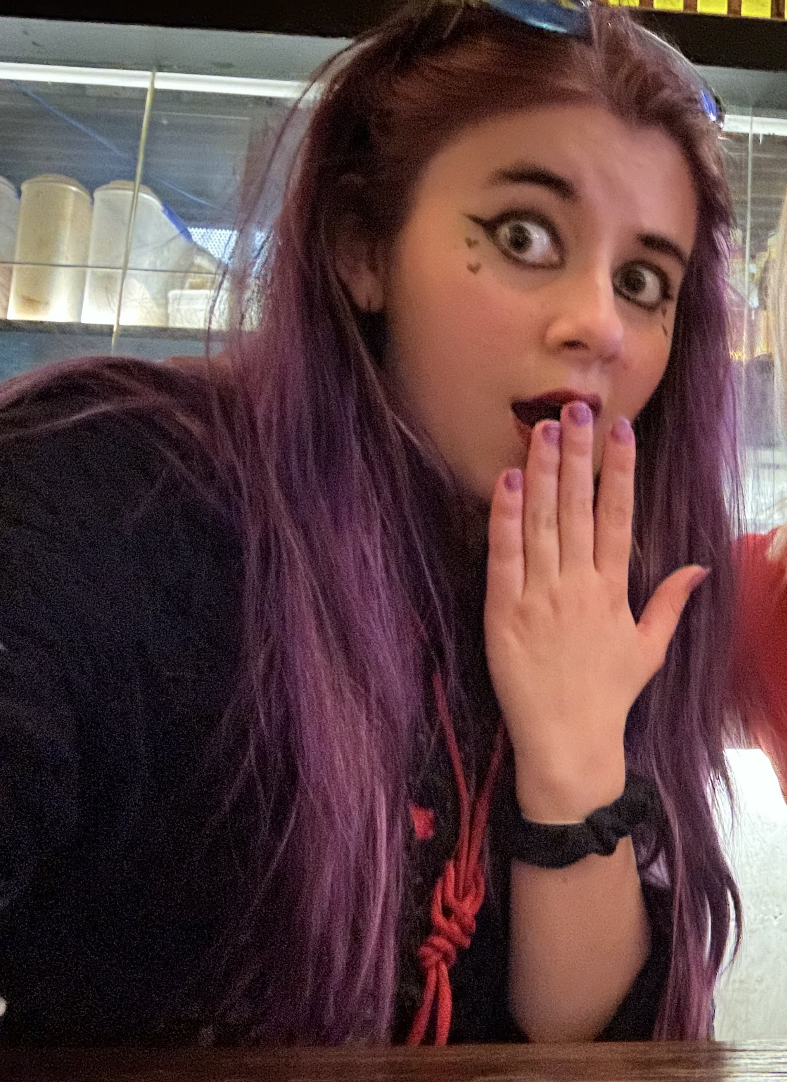
About me
22 years old
Aspiring game developer and 3d modeler
From the gold coast
Builds character ai models in my free time/ digital artist/ chronic gamer and procrastinator

Slide 3
Application purpose
Chattea is meant to bridge the gap between online users trying to find local communities and cafes trying to gain traction through potential social customers.
Reaching out to a more digitised audience that is used to social media more than interpersonal interactions, Chattea uses its unique personality to draw them out and aid them in finding connections both online and in person.
Chattea utilises gamification to create a unique social media experience, aiming for a spectrum of people from tech enthusiasts to baristas. Adding to the unique experience, all coffee related preferences and interests heavily influence the user interface’s design uniquely for each user, making the website feel personalised whilst maintaining its branding.

Slide 4
Objectives
“The objectives of Chattea align perfectly with contemporary business strategies aimed at harnessing digital innovation to enhance customer experiences. By targeting audiences who are more inclined to engage with digital platforms, Chattea positions itself as a leader in the niche market of coffee enthusiasts.” ¹
Chattea is guided by the following objectives:
Build interactive branding
To network
To heighten public interest
To serve the local market
To make business information available

Slide 5
Scope
Chattea aims to become a larger social media platform on a similar scale to SpaceHey or Tumblr. With friend-finding capabilities without absorbing the tinder demographic as an unintended consequence (as noticed by other friend finding networks like Friender.) and becoming a dating site (like https://boo.world/ ).
Relation of software to target market and business strategies
By observing strategies used by competitors in the friend finding market, Chattea will utilise working strategies of successful social media and successful local coffee stores.
Chattea’s target audience would ideally be within the age range of 18-35, familiar with modern technology but also capable of exploring the physical world as capable adults. Users of any gender and background should feel invited to use this site, by encompassing a coffee theme that is not particularly gendered.

Slide 6
List of top 5 Prioritized Objectives
Item | Justification | Priority [1...5]
Build interactive branding | The characterisation of Chattea is definitely the most important aspect in order to make it the application engaging and memorable | 1
To network | Chattea is a social networking app and will hugely rely on user interaction | 2
To make business information available | Café businesses are given publicity and will encourage users to look at their menus and products | 5
To heighten public interest | Chattea is meant to bring more attention to local coffee shops and bring out the online community into a real life cafe | 3
To serve the local market | As a result of helping bring the online community into physical places, this would serve the coffee shops this product is aimed towards | 4

Slide 7

A general description of the user. |  | Small PHOTO
24 – Jessica is a university student studying marketing at Griffith university. She is 24 years old and has played the occasional video game, enjoys time at cafes with friends. Loves a strong macchiato, social and looking for more ways to connect with people in her city. |  | https://www.shutterstock.com/image-photo/happy-young-woman-sitting-on-sofa-2018571389
USER OBJECTIVES (why will the user use your application)
USER PROFILE Name | Jessica
Gender/ age group | Female, 22
Experience | Frequently uses insta, often working on Word and Excel
Education | University
Occupation | student
Residence | Brisbane, Australia
Computer Literacy | Very digitally literate – grew up using websites and social media
Other
USER EXPECTATIONS (what will the user expect to experience with the application)
Wants to find people to chat with
Wants a fun experience
Wants to find hot new cafes to find
Aesthetically pleasing interface; something with character to stick with
Clear and cohesive to use; professional and easy to use

Slide 8

A general description of the user. |  | Small PHOTO
Taurice is a 27 year old man in touch with his hipster side. He is a data analyst interested in finding network connections outside of his industry that enjoy playful websites the way he does. He frequently works by himself in coffee shops and wants to utilise the opportunity to make friends. |  | https://stock.adobe.com/au/search?k=hipster+man&asset_id=358963916
USER OBJECTIVES (why will the user use your application)
USER PROFILE Name | Taurice
Gender/ age group | Male 27
Experience | Obsessed with technology, mastered coding at age 10, not so great at socialising. Can play doom on a calculator
Education | University level, master’s in computer science
Occupation | Data analyst,
Residence | Melbourne, Australia
Computer Literacy | Very digitally literate – grew up using websites and social media
Other
USER EXPECTATIONS (what will the user expect to experience with the application)
Seeking a non-intimidating and unique social media experience
Wanting to network with people outside of his industry; yet share a similar interest in user experience (finding fun in website use)

Slide 9
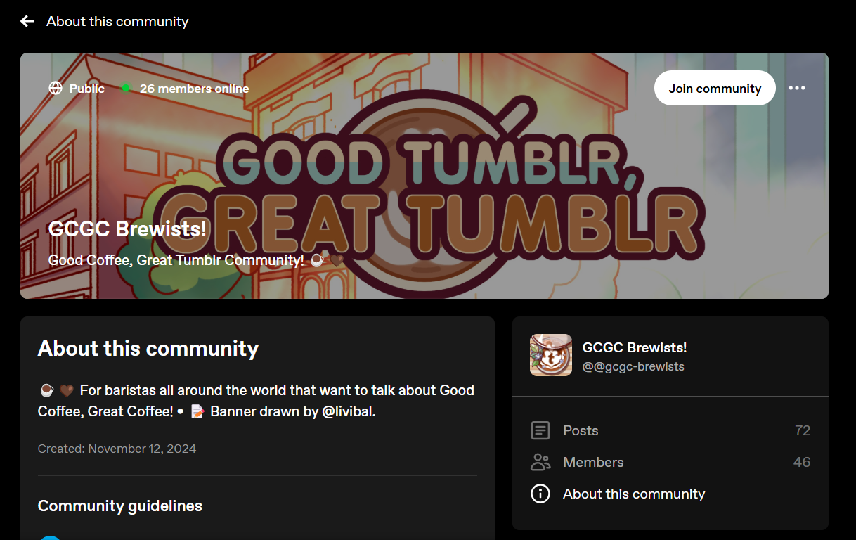
Competitor 1: Communities tab on Tumblr
Font: 1 Colour: 0.5 Contrast: 0.5 Repetition/unity: 1 Proximity: 1
Application total Score | 4/5
Application average Score (total/no items) | 0.8/1

Slide 10
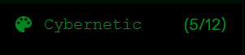
Colour: beautiful dark aesthetics, complimented by bright coffee banners and clean, crisp design. A very good application of colour would be with the pallete changing feature, able to switch from 12 different preset styles.
These styles don’t quite make the most sense unless you were interested in the 15 specific themes it has premade for the user
Font: only two fonts; one for the iconic logo design, and the rest for sub-information, such as the number of members online. Good application, keeping consistency throughout the site.

Slide 11
Contrast: does great at organising the user’s attention to high priority information first (like focus on the community categories with relevant photos in order to guide the user into picking one). However, it uses this contrast to become rather irritating to do tasks the user has to do (the purple banner to insist the user signs up or logs in) Repetition/Unity: the integration of the communities tab only allows a few changes of the ui that the community creators can make on their pages. This is both limiting and an a good execution of unity that makes it clear that you are still on tumblr regardless of what topic you may be interested in. This level of collaboration will likely be integrated into Chattea, for when suburbs and coffee shops wish to create their own lobbies with personalisation. Proximity: Tumblr effectively uses spacing inbetween sections to clearly define the difference between each community and the site itself.

Slide 12
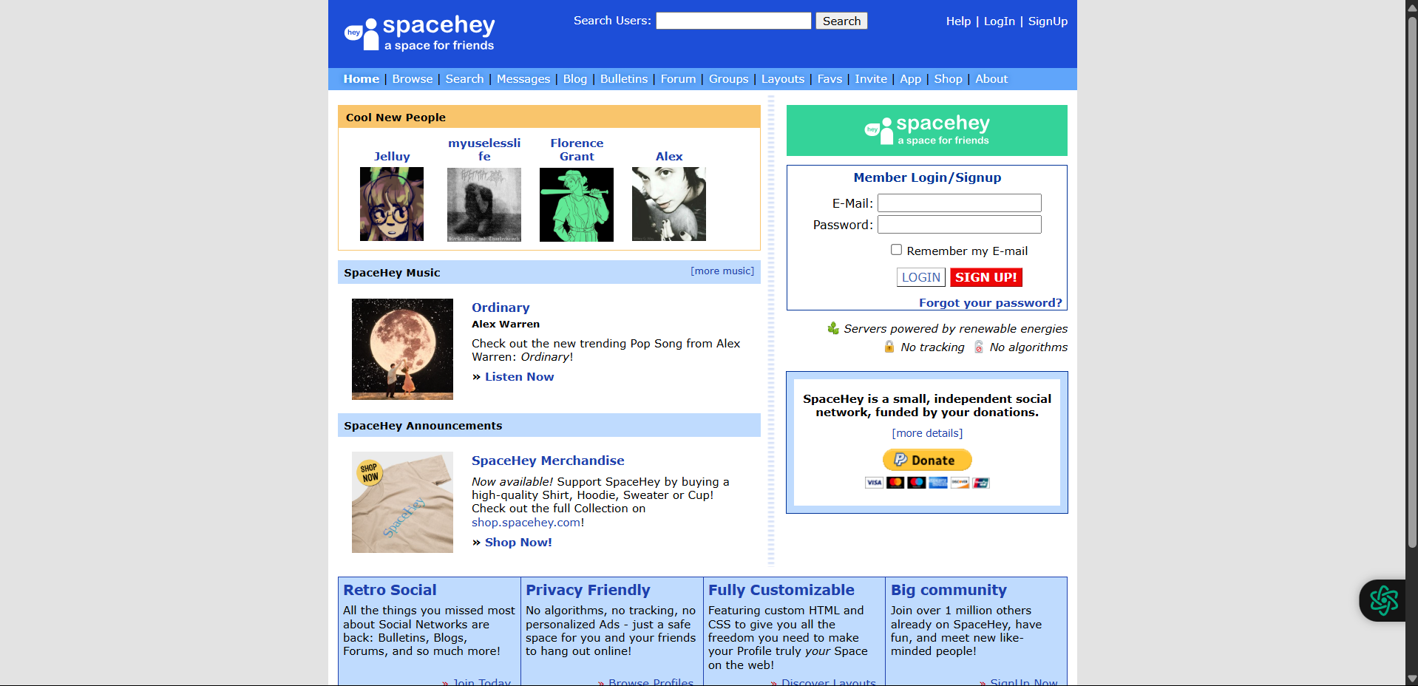
Competitor 2: Space Hey – A MySpace copy
Colour: 0.5 Font: 0.5 Contrast: 0.5 Alignment: 0 Proximity: 1
Application total Score | 2.5/5
Application average Score (total/no items) | 0.5/1

Slide 13
Colour: The use of colour is organised but overused; the use of blue for general information, green for the login section, and yellow for vital information. Whilst it makes sense, it is also confusing and cluttered for users. This is especially the case when also considering the constant shifts of black, grey, and white. Only in the custom user content is this issue fixed to look aesthetically pleasing, and so community content does add to the visual appeal of this site. Font: in order to stick to more nostalgic themes, this site has made the creative decision to stick to lackluster fonts. Whilst it is recognisable, the limitation of imitating outdated websites holds the design back, leaving choices like these with more to be desired. Contrast: Contrast on SpaceHey seems driven by its color scheme—bright primaries against black or white backgrounds aim to separate elements like profile sections, navigation, and user content. This emphasis contrast highlights key areas (e.g., yellow for vital info), but the overuse of high-saturation colors and minimal tonal variation creates visual noise rather than clarity. Size and shape differences (e.g., bold text or blocky layouts) might amplify this, but without restraint, it feels chaotic. The intent is likely to mimic the cluttered charm of MySpace, yet it risks alienating users who need clear distinctions without strain. Repetition/Unity: Repetition likely appears in consistent use of bold colors (blue, green, yellow) across headers, links, and buttons, alongside a uniform font and boxy layout grids typical of early web profiles. This creates a sense of wholeness—uniting the site under a recognizable retro identity—but the lack of subtle tints or modern spacing makes it monotonous rather than cohesive. Repeating such loud elements without variation misses an opportunity to refine unity, leaving the design feeling more like a pastiche than a polished tribute.

Slide 14
Alignment and proximity: alignment might lean toward basic left (for text) and centered text blocks, with graphics and user content stacked in tight, grid-like rows reminiscent of MySpace’s profile pages. Margins take up majority of the page, ignoring golden mean or rule-of-thirds principles for a dense, utilitarian look. This choice prioritizes function (fitting lots of info) over form, aiming to replicate the cluttered charm of the 2000s, but it sacrifices breathing room and elegance, making navigation feel cramped and haphazard. Even custom profiles (like the one provided) also suffer from the same centre alignment issues to maintain unity with the rest of the site. This itself shows limitations that were unnecessary had the site not been laid out in this way.

Slide 15
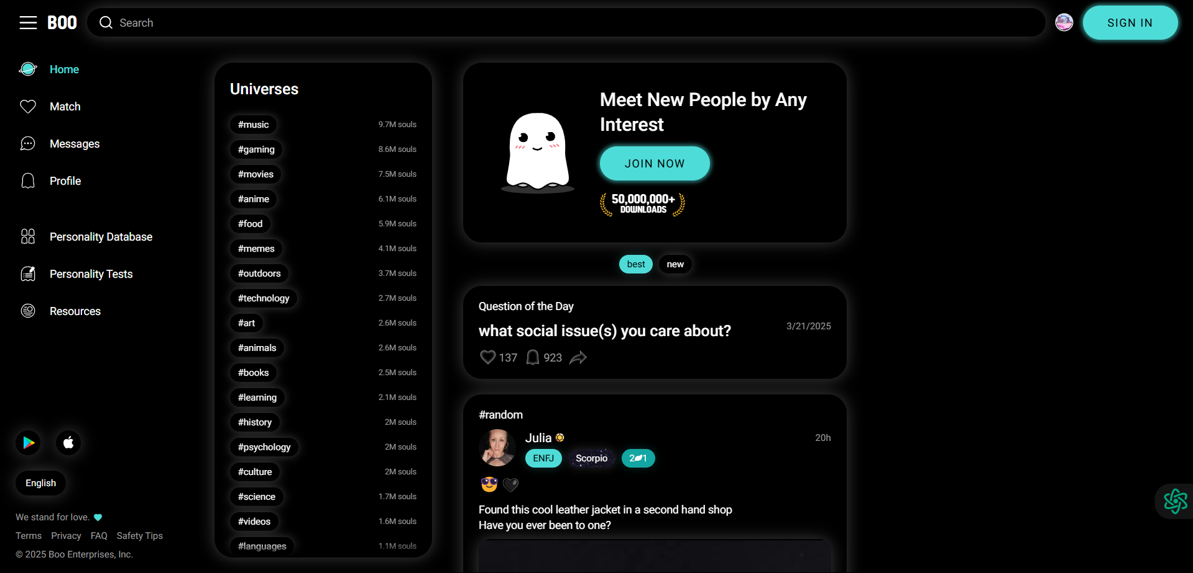
Competitor 3: Boo– A dating site turned friend making site
Colour: 1 Font: 1 Contrast: 0.5 Repetition/Unity: 0.5 Alignment: 0.5
Application total Score | 3.5/5
Application average Score (total/no items) | 0.7/1

Slide 16
Colour: boo mostly sticks to a black oriented theme, having white glowing accents as a complimentary theme to show the shapes of the boxes (as there are no outlines, the boxes themselves are animated with css to shrink and grow based on cursor hover. A cyan/ice blue is used to highlight importance, like the insistence to sign in, show the home page, sign up, or display the personality types of the users that are posting on the site. Compared to SpaceHey’s cluttered retro palette, Boo’s choices might be more cohesive but risk being too dating-centric, which Chattea aims to avoid. Font: Boo opts for clean, modern sans-serif fonts, prioritizing legibility and a contemporary vibe to appeal to a tech-savvy 18-35 demographic. These choices could enhance readability for profile text or compatibility metrics, reflecting a focus on user data presentation. The rationale likely ties to professionalism and ease of use. Contrast: The contrast of this site is moderate and well applied; solid black to appeal to the more modern trend of having dark mode for users who intend to chat late at night. Pops of colour show up now and then to highlight importance. This emphasis contrast separates key features from profile content, aiming for usability in a dating context for a gamer centric audience. The glowing comes off a bit cheesy, which makes the site harder to get used to compared to more sleek and professional designs like tinder.

Slide 17
Repetition/Unity: Boo repeats icons (e.g., hearts, chat bubbles) and color tints across profiles and menus to unify its dating theme, creating a consistent "matchmaking" feel. This repetition reinforces brand identity but might overemphasize romance, clashing with Chattea’s platonic goals. Chattea could repeat coffee cup motifs or chat bubble styles in a subtler way, tying lobbies and profiles together for a cohesive, community-driven aesthetic without dating undertones.
Alignment: Boo’s alignment is grid-based and centered with a left-aligned menu, optimizing for mobile swiping or profile browsing. This logical placement aids navigation but might feel rigid for a social platform. Chattea could adopt a looser, organic alignment (e.g., slightly offset lobby cards) inspired by Tumblr’s casual flow, reflecting coffee shop informality while maintaining readability, avoiding Boo’s overly structured feel.

Slide 18
SUMMARY - COMPETITIVE REVIEW of THREE APPLICATIONS
 | URL | Description
1 | https://www.tumblr.com/ - communities tab (relatively new feature) | A clever incorporation of reddit’s subtopics adapted and changed into a “communities” tab that allows users to explore and interact with more people aside from using the hashtags or having only their mutual’s posts on their feed – expands the horizons of how far tumblr can connect users, ultimately being a net positive for the site’s popularity
2 | https://spacehey.com/ | A website that aims to capture the internet renaissance (early 2000’s and 1990’s) by recreating myspace, allowing users to inject their own html and css on their page to design their own webpage.
3 | https://boo.world/ | A website that specialises as a dating site – acting as a friend site as a secondary function. Mainly targets gamers as its ideal audience (shown from advertising)
Recommendations and review for proposed Website based on competitor Website analysis: Palette: create a personalised and unique palette that can be toggled and refined by the user; special feature must be coffee themed, adding to the charm of the site Lobbies: able to be created and optimised by the user; generate a community through the use of self-moderation. Avoid dating cliches: avoid pushing “matches” for users, and instead use compatibility to put users together in groups, rather than 1 on 1 matching. Make site as safe as possible due to the use of localisation of users; safety is extremely important to prevent data breaches or threats. Design elements: learning from the mistakes of SpaceHey and taking inspiration from tumblr and Boo, despite the functionality of boo not fitting our intended target audience. the community contributions range widely across the three applications analysed. SpaceHey does it with most creative liberties allowed, Tumblr has tight restrictions but still allows for community creation and contribution, whilst boo only has the ability to post. A happy medium between spacehey and tumblr should be integrated into chattea. Personality testing: Boo has shown a lot of traction regarding its use of quizzes to further personalise a users custom profile in order to better match them with other users. This could be integrated by assigning different types of coffee according to personality quiz results; giving more to the coffee theme and branding whilst giving unique information for each user to have to better identify themselves in a lobby. This will be shown in the stats section for each lobby, giving some icebreakers for users. All 3 websites have a lot of gamified elements that can be used as inspiration to make chattea more fun to use, like a points system and granting special titles to users. Boo targets a similar 18-35 tech-savvy crowd but leans into romance, unlike Chattea’s coffee-shop-inspired, gender-neutral social vibe. Chattea could borrow Boo’s clean UX but adapt local coffee store tactics (e.g., warm aesthetics, community boards) to stand out.

Slide 19
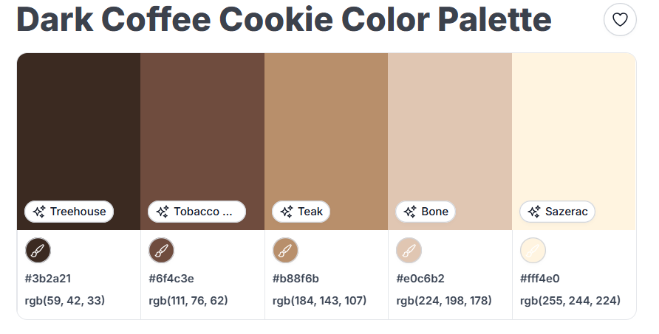
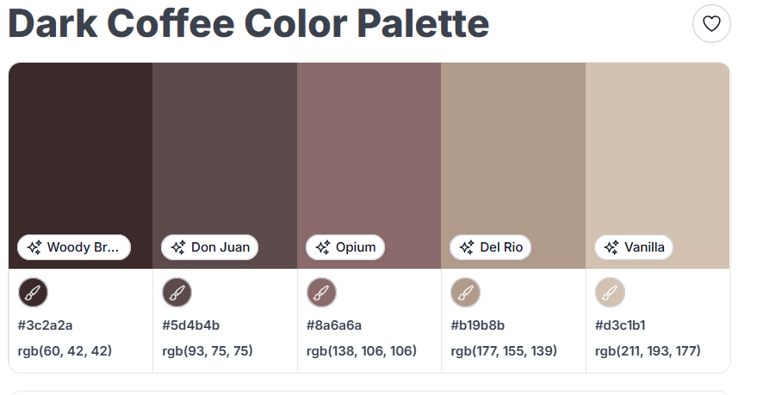
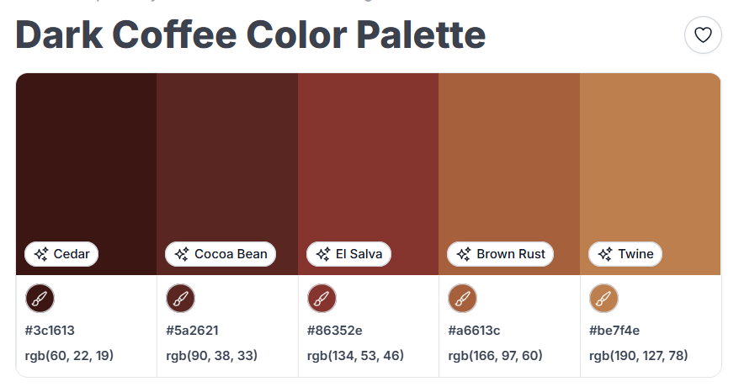
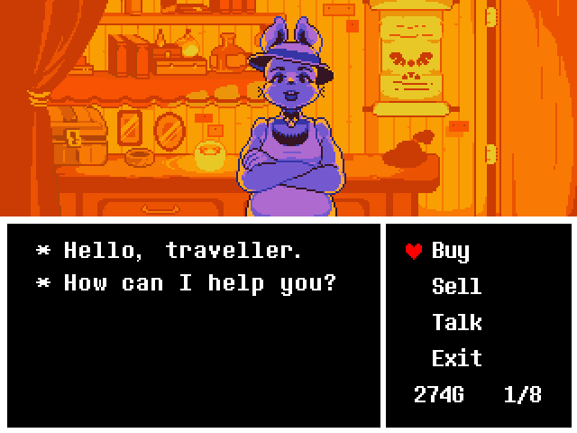
Colour schemes and inspiration

Slide 20
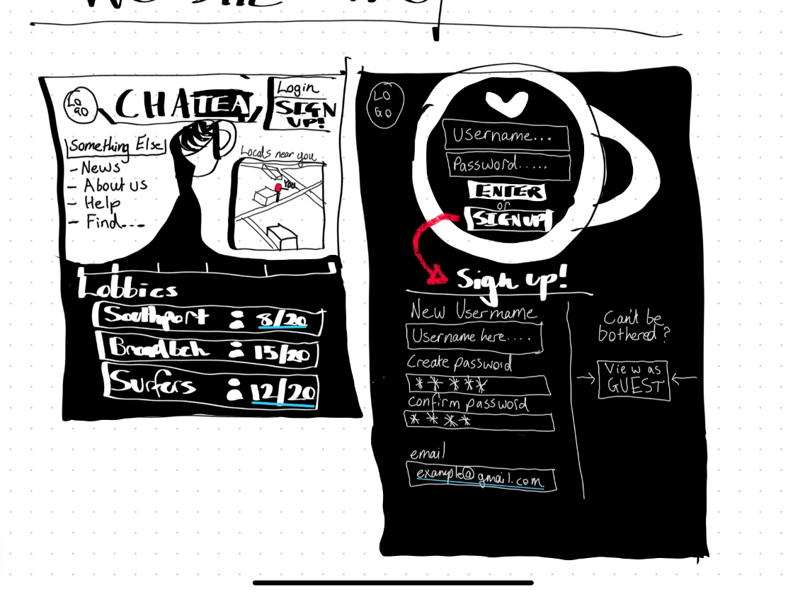
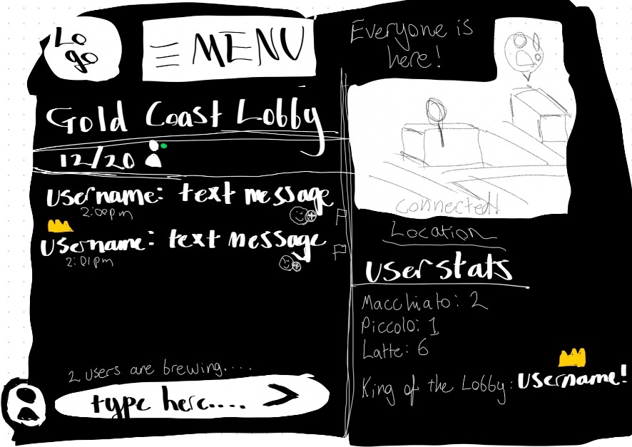
wireframes

Slide 21
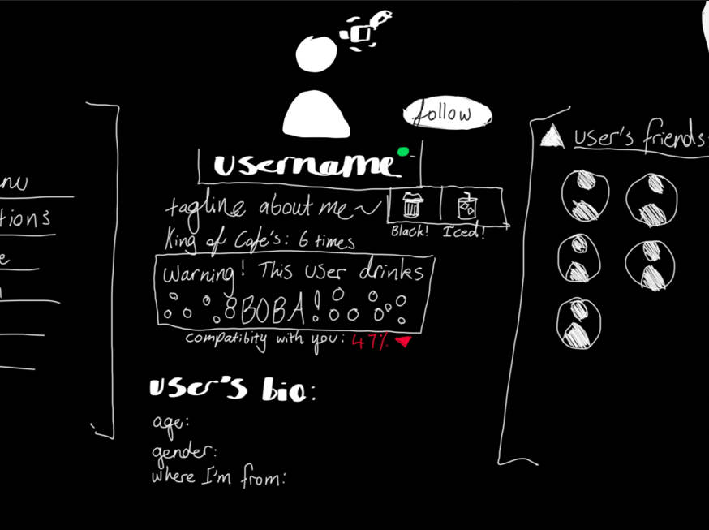
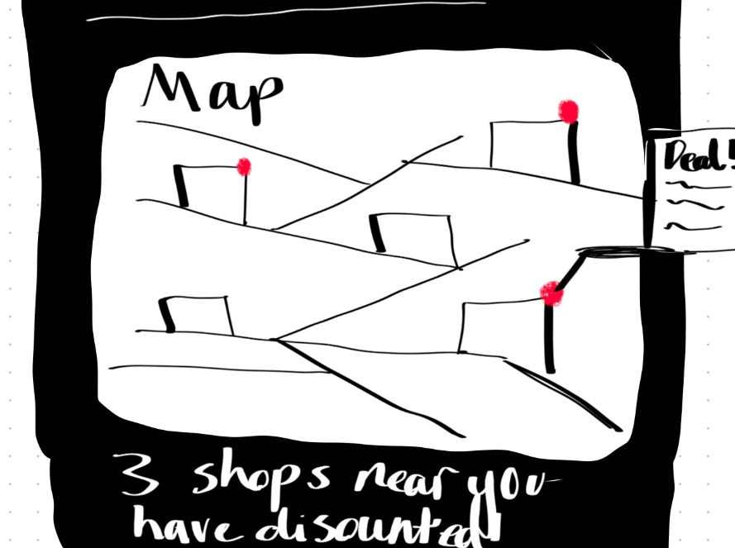

Slide 22
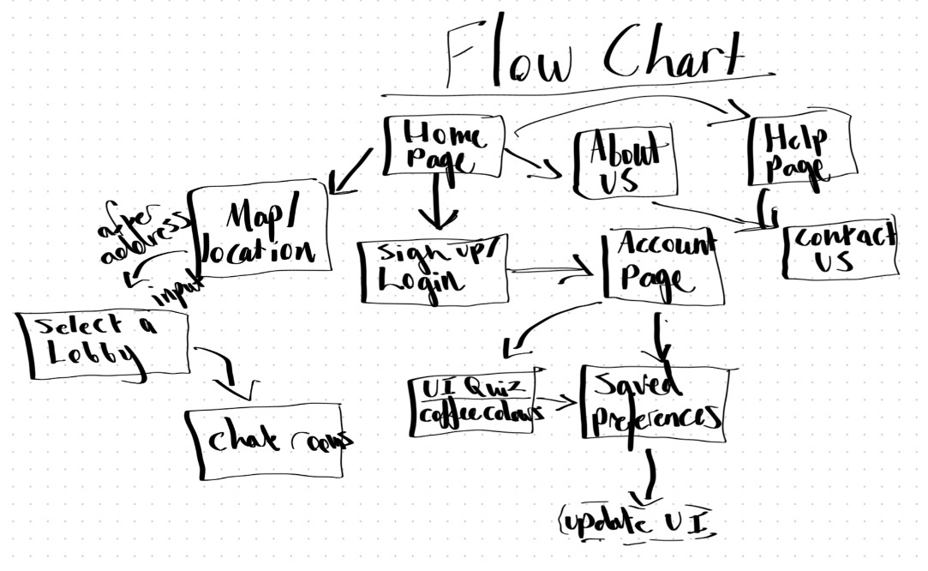

Slide 23
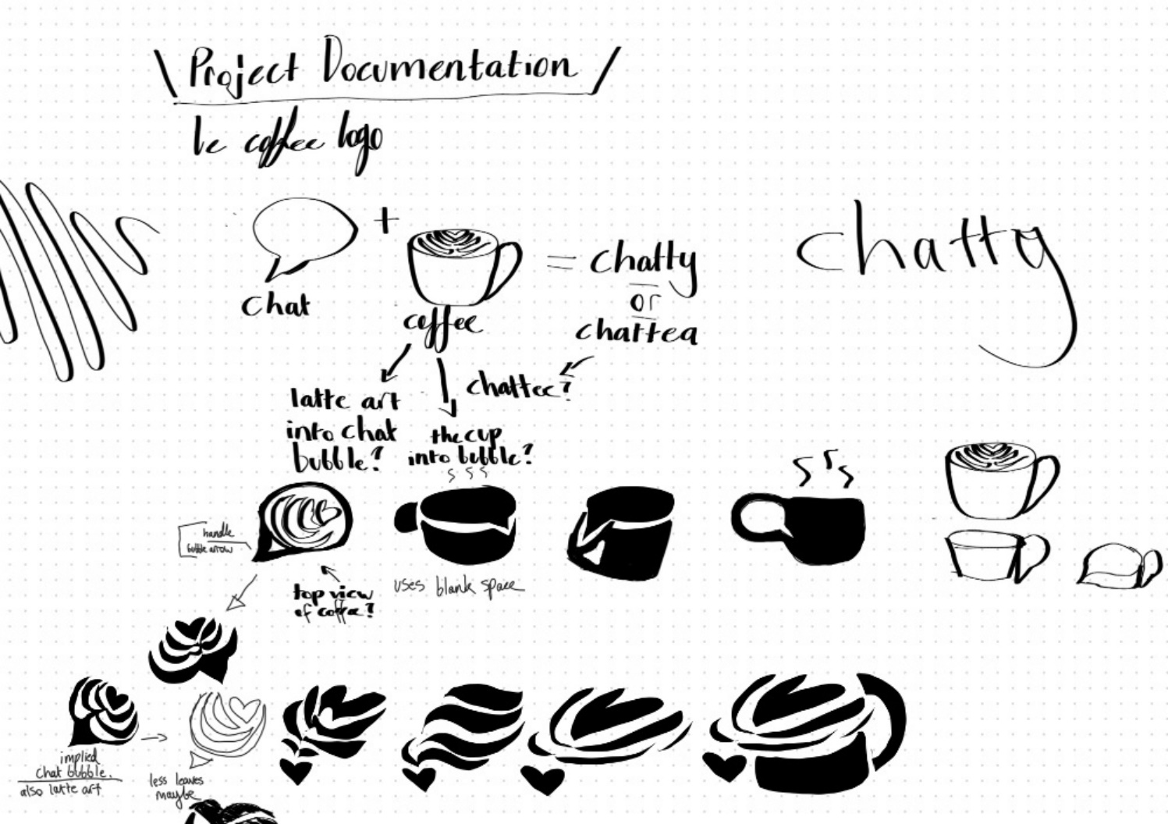
Logo Design Progress
Chattea intends to incorporate its main themes of being coffee centred and social. The symbols chosen to represent these themes were the coffee cup and the speech bubble. Below are the prototype designs of what the logo may look like.

Slide 24
Content justification/comments >>>>> Chattea will rely on css and html, including javascript injections that will allow for more complex features (such as the map). Sound effects and animations will all be made in css. Sources for code that will be used: https://www.w3schools.com/css/css3_animations.asp <=== css animation sources https://www.w3schools.com/htmL/html_scripts.asp <=== html java sources
Colour The coffee themes will be determined by a personalised quiz that asks the user what their favourite type of coffee is. If they prefer hot coffee, it will switch to the warm colour palette. If they prefer iced coffees, it will switch to the cool colour palette. These will both include a light mode and a dark mode. This personalisation should make the user experience more special for each individual.

Slide 25
Font Font rationale: Chattea will be using a combination of fonts, mainly a mix of calligraphy and pixelization. The calligraphy will be used in order to pull more connections to the theme of coffee shops; as a lot of these stores mainly use calligraphy as their identifying typography style. https://www.fontspace.com/glitch-font-f99045 inspiration: Undertale character item shop – Undertale [the contrast of the images having bright orange and yellows, compared to the black ui with white text plus red to indicate importance – will likely be implemented directly due to the striking and effective look it demonstrates. Though this will evolve into the coffee theme as this site develops.]

Slide 26
Contrast The contrast will take inspiration from retro interfaces such as Undertale and SpaceHey, due to the target demographic being ideally born from 1990-2000, and will incorporate the stark contrasts from that time in order to appeal to these audiences. Attracting the demographic that enjoys character from sites will gain the ideal users intended for this site. using contrast sparingly (e.g., a rich coffee brown against cream) to emphasize group lobbies over individual matches, keeping the focus communal and safe.
Repetition /Unity To create visual consistency, users will only be able to change their profile pictures and the banners of lobbies, in order to maintain the ideal atmosphere for this site. The coffee colours and coffee cups + animations will be the main glue in holding this unity together, creating branding that should stick due to its bright and iconic personality.
Alignment Some rules of alignment that would be consistent throughout the site would be the main logo being on the top right of the page. Menus will remain in the same spots to reduce the amount of memorising a user would need in order to navigates across pages. Least important information remains at the bottom of the page, and the most relevant will remain in top right to top centre alignment. Secondary information will follow below, going to middle right, and the rest of the page fits into the leftover left alignments.

Slide 27
Proximity Keeping minimal distance between relevant topics, only dividing when each section should be considered separately. For example, the login page should have its login details in close proximity of eachother, whilst the sign up section should be divided through the use of blank space to separate these sections. Lines will also be used to group information together, but less often, in order to remain minimalistic to maintain a clean design. Username and user profile will be conjoined; followed by a small space to separate identity with message when looking at the chat history in the lobbies.
Input Interface Simplistic design to shorten the learning the curve as much as possible Intends to have cross compatibility across all devices; mobile and desktop based. Will have assisted alt text for each image in order to be more accessible for those with disabilities. Safety countermeasures; each user will not have their location revealed to other users, and users must consent to picking their city in order to categorise themselves into lobbies that are local. More safety nets will be added as the prototype develops.
Output Interface Screen design (responsive across devices) Menu interface design (hidden) Visual feedback: animation per hover and click Auditory feedback: subtle sound effects that activate when confirming something important or alerting of something important

Slide 28
Thank you

